Slide 1
Immigration
Push and Pull Factors

Slide 2

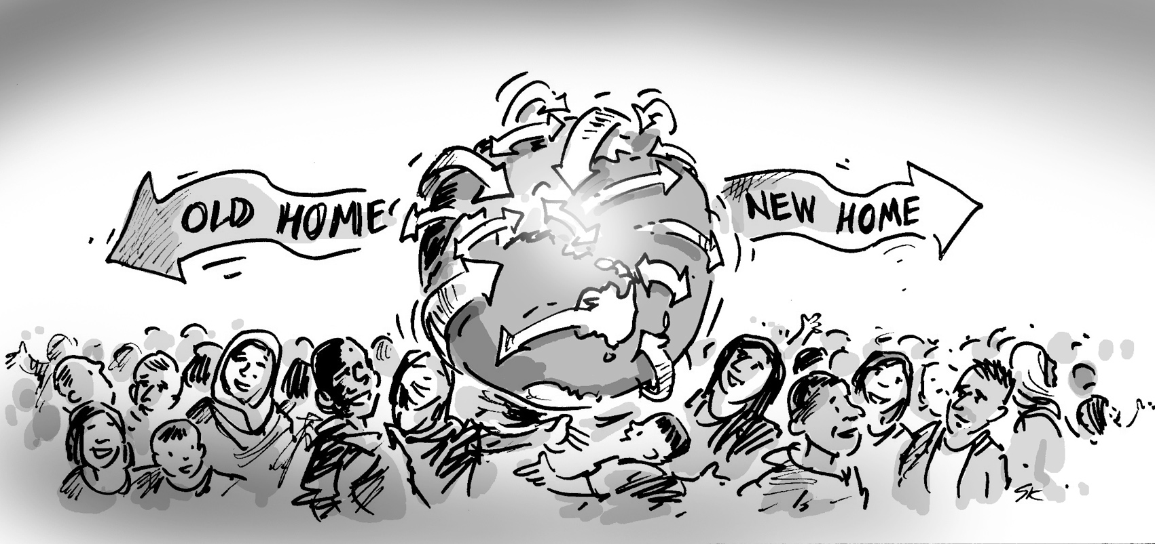
Immigration
Internal Migration
International Migration
Human migration / Change of Residence within the same country.
Human Migration / Change of Residence over national boundaries (to other countries)

Slide 3
Why do people move ?
People immigrate because of push and pull factors.

Slide 4
Push Factors
Pull Factors
Factors that force a person to move out of their country
Emigration
Factors that encourage a person to come to a new country
Immigration

